Slide 1
Nonlinear Time Series Analysis
Daniel Primosch, Luke Fairbanks

Slide 2
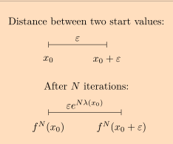

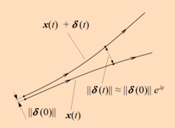
Lyapunov Exponents
characterizes the rate of separation of infinitesimally close trajectories
two trajectories in phase space with initial separation vector diverge (provided that the divergence can be treated within the linearized approximation) at a rate given by
rate of separation can be different for different orientations of initial separation vector => spectrum of Lyapunov exponents
maximal Lyapunov exponent (MLE), because it determines a notion of predictability for a dynamical system. A positive MLE is usually taken as an indication that the system is chaotic

Slide 3
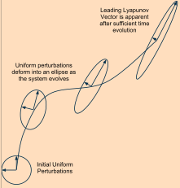


Lyapunov spectrum
For a dynamical system with evolution equation in an n–dimensional phase space
spectrum of Lyapunov exponents
Lyapunov exponents describe the behavior of vectors in the tangent space of the phase space and are defined from the Jacobian matrix

Slide 4



Lyapunov spectrum
Jacobian defines the evolution of the tangent vectors, given by the matrix Y via the equation
initial condition
Matrix Y describes how a small change at the point x(0) propagates to final point x(t)
Limit defines the matrix (Lambda) whose eigenvalues correspond to the lyapunov exponents

Slide 5
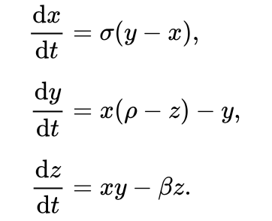
Lorenz 63 (briefly)
Crude model for buoyancy driven dynamics in the atmosphere
Chaos

Slide 6
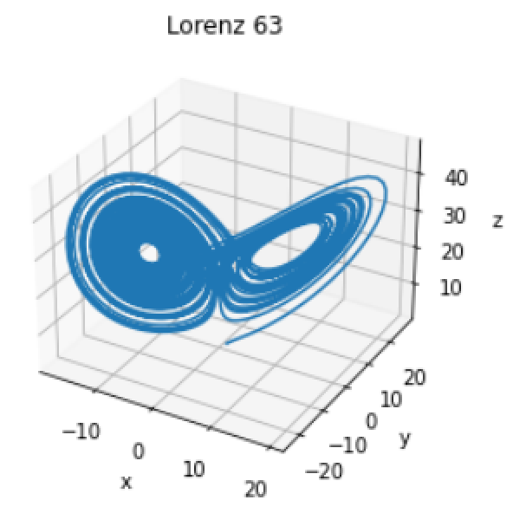
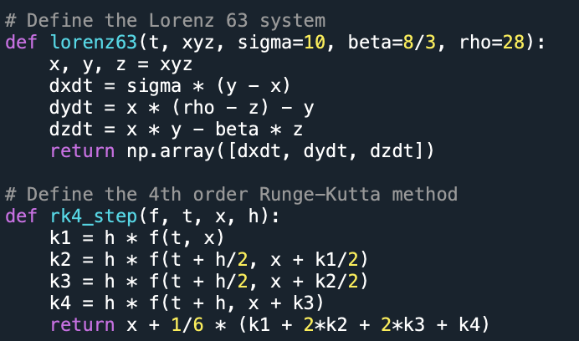
Simulating Lorenz 63

Slide 7
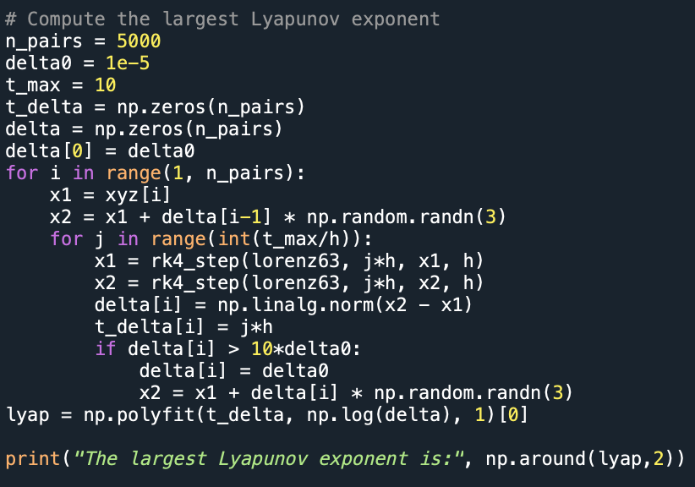
Analysis of Lorenz 63 - Lyapunov Exponent (Brute Force)
Approximate
Becomes more accurate with longer the trajectory

Slide 8
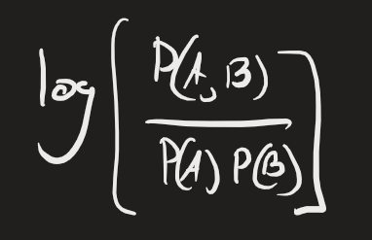
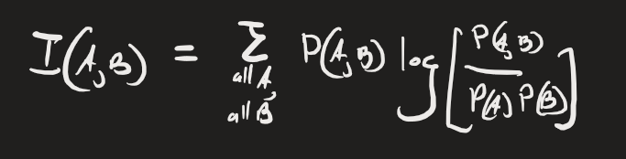
Average Mutual Information
mutual information of two random variables is a measure of the mutual dependence between the two variables
"amount of information" obtained about one random variable by observing the other random variable
Mutual info
(Between sets A and B)
Average Mutual info

Slide 9
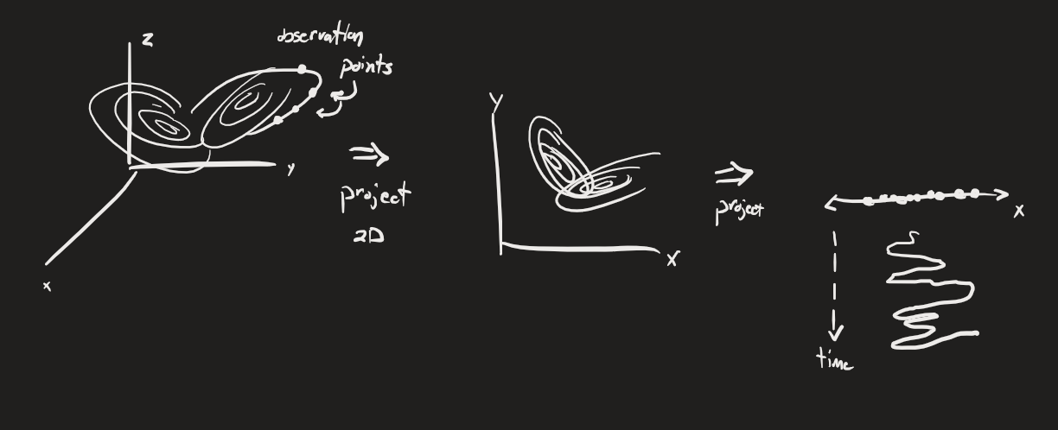
False Nearest Neighbors
Method to determine embedding dimensionality of an attractor in phase space by measuring how many (time delay embedding) dimensions are required to sufficiently ‘unfold’ the low-dimensional measurements from attractor

Slide 10
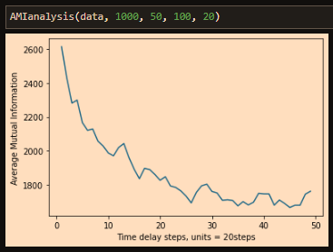
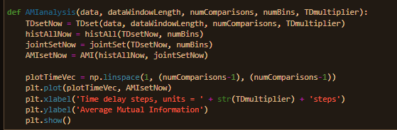
Average Mutual Info code results
Code to plot AMI vs tau time delay parameter

Slide 11
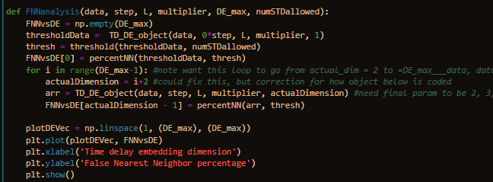
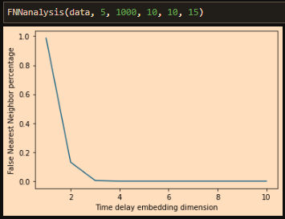
False Nearest Neighbors code results

Slide 12
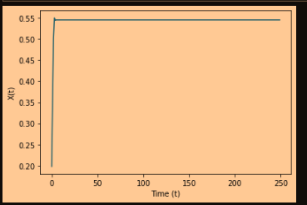

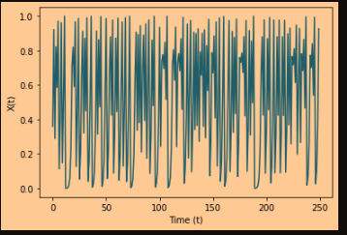
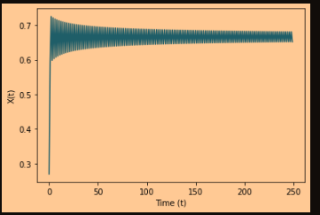
Logistic map: testbed for chaos
As parameter r is varied from 2 -> 4, behavior exhibits more chaos
R = 2.2, fixed point
R = 4, chaotic
R = 3, limit cycle

Slide 13
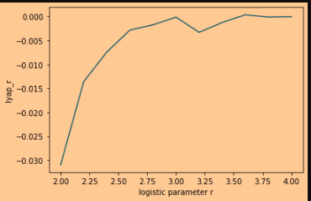
(Rosenstein) maximal lyapunov exponent
Estimate of the largest lyapunov exponent
Positive value indicates chaos

Slide 14
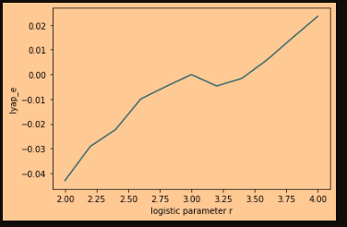
(Eckman) lyapunov spectrum: maximum
Estimate of the largest lyapunov exponent, by taking maximum of lyapunov spectrum
Positive value => chaos

Slide 15
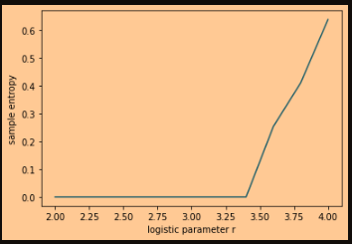
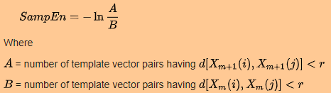
Sample entropy
negative natural logarithm of the conditional probability that two sequences (similar for emb_dim points) remain similar at the next point, excluding self-matches
a lower value for the sample entropy therefore corresponds to a higher probability indicating more self-similarity

Slide 16
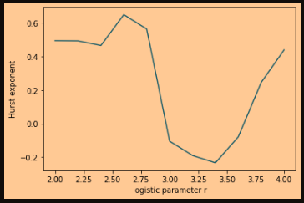
Hurst exponent
estimated Hurst exponent K using a rescaled range approach
(if K = 0.5 there are no long-range correlations in the data,
if K < 0.5 there are negative long-range correlations,
if K > 0.5 there are positive long-range correlations)
Long-range correlation: statistical dependence between distant subsequences

Slide 17
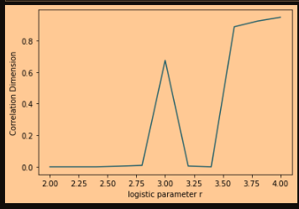
Correlation Dimension
correlation dimension as slope of the line fitted to log(r) vs log(C(r))
characteristic measure that can be used to describe the geometry of chaotic attractors
defined using the correlation sum C(r) which is the fraction of pairs of points X_i in the phase space whose distance is smaller than r.
If the relation between C(r) and r can be described by the power law
C(r) ~ r^D

Slide 18
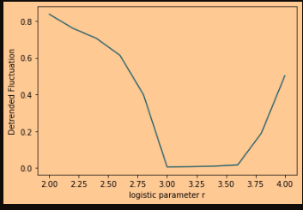


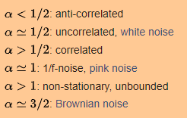
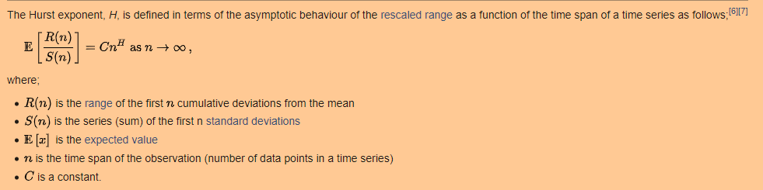
Detrended Fluctuation Analysis
the estimate alpha for the Hurst parameter
Measure of long term statistical dependencies

Slide 19
Colpitts Oscillator
Constant DC Power Source
Feedback loop (non-linear) of capacitors and inductors
=> source of oscillations (radio signals, etc)

Slide 20
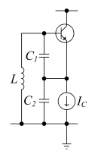
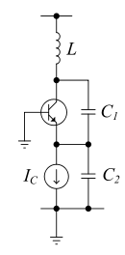
Colpitts Oscillator: circuit
Credit: Daniel Creveling

Slide 21
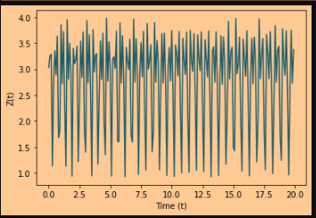
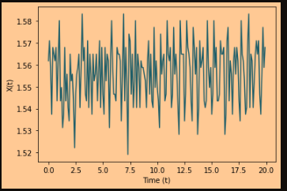
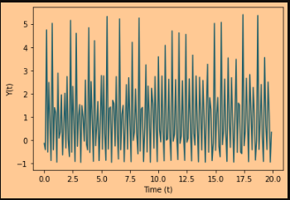
Colpitts Oscillator: dynamics
X data
Y data
Z data
X data

Slide 22
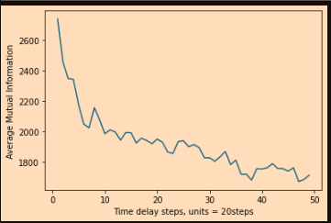
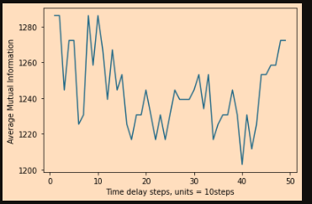
Colpitt’s Average Mutual Information
Y data
X data
Z data

Slide 23
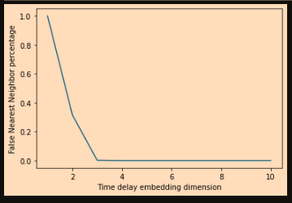
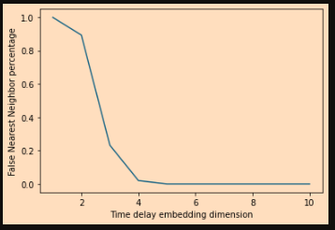
Colpitt’s False Nearest Neighbors
Y data
X data
Z data

Slide 24


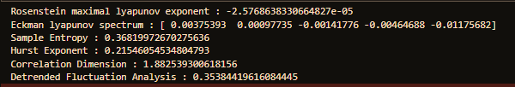
Colpitt’s metric results
X data
Y data
Z data

Slide 25
Metric notes
Lyap_r: positive means chaos
Lyap_e: positive means chaos
Sample entropy: lower value corresponds to more self-similarity
Hurst exp: if K < 0.5 there are negative long-range correlations, else positive long-range correlations
Correlation dimension: geometry of chaotic attractors
Detrended fluctuation analysis: long term statistical dependency, stationarity loss beyond alpha = 1

Slide 26
TISEAN software - ‘Why re-invent wheels when they’ve been optimized already & we could get on with building cars’
Example functions
Autocorrelation of time series
correlation dimension
detrended fluctuation analysis
Fourier transform spectrum
information-entropy causality
Lyapunov spectrum
nonlinearity of a time series
predicts the future values of a time series using a fitted model
recurrence quantification analysis
….and much, much more!

